Slide 1
The Challenges of Validating R
R in Pharma Workshop

Slide 2
Who are you?
Statistician?
Programmer?
DevOpps?
Data Scientist?
Pharmacometrician?
Bionformatrician?
Lost?

Slide 3
Who am I?
Andy Nicholls (@andyofsmeg)
Statistician and Data Scientist
Josh Wills on Twitter: "Data Scientist (n.): Person who is better at statistics than any software engineer and better at software engineering than any statistician."
Currently work in GSK’s new Statistical Data Sciences team
BSO for R HPC Environment for Stats and Programming
Member of PSI Application and Implementation of Methodologies in Statistics SIG
Focus on R Validation
Previously PM, Tech Lead and Product Owner for Mango Solutions’ ValidR
DISCLAIMER: I speak for none of the above organisations!

Slide 4
Workshop Outline
Setting the scene – 20 mins
Overview key regulatory information on validation
Breakout discussions on key topics – 20 mins
Summary of discussions – 15 mins

Slide 5
Setting the Scene
Overview
Background and definitions
Validation
Base R
R Packages
The R Consortium Project

Slide 6
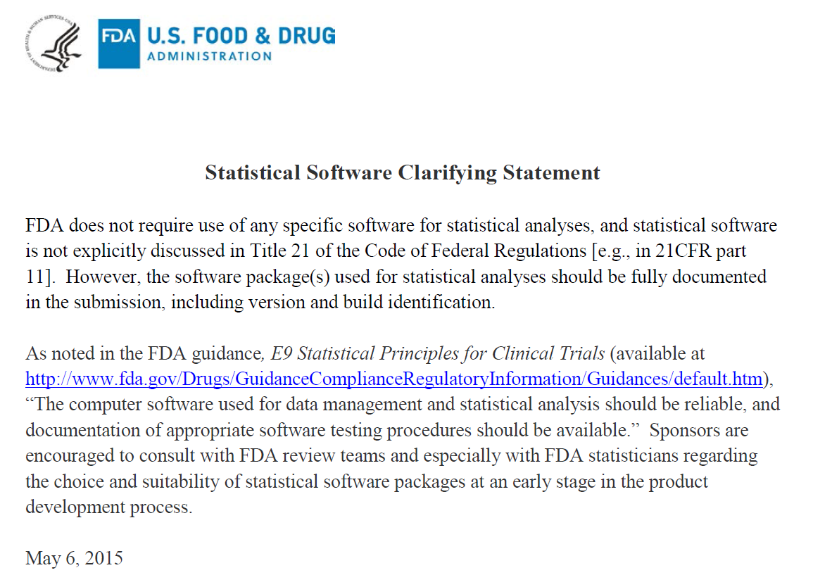
https://www.fda.gov/downloads/ForIndustry/DataStandards/StudyDataStandards/UCM587506.pdf

Slide 7
FDA
Statistical Software Clarifying Statement
“FDA does not require use of any specific software for statistical analyses, and statistical software is not explicitly discussed in Title 21 of the Code of Federal Regulations [e.g., in 21CFR part 11]…”
May 6, 2015
https://www.fda.gov/downloads/ForIndustry/DataStandards/StudyDataStandards/UCM587506.pdf

Slide 8
Background
We don’t have to use SAS for statistical analysis
Use of R remains limited
Why?
SAS is the best thing ever invented?
R is rubbish?
Lack of knowledge/training?
Lack of understanding of regulatory requirements?
Goal of the PSI AIMS SIG is to improve knowledge and understanding in these areas
Notes:
SAS XPT format is a required format for submissions – actually now easier to produce in R than SAS!

Slide 9


AIMS SIG
Application and Implementation of Methodologies in Statistics (AIMS)
Formed in May 2016
Representatives from PPD, PRA, Syne Qua Non, Servier, Bordeaux University Hospital, Clinical Epidemiology Unit, Roche, GSK
Looking to expand membership
Current focus on the use of R software in the industry and validation of R specifically
Recently initiated an R Consortium project to build a Validation Hub
More later
https://www.psiweb.org/sigs-special-interest-groups/aims

Slide 10
Some Definitions

Slide 11
Definitions
Validation (FDA) - Establishing documented evidence which provides a high degree of assurance that a specific process will consistently produce a product meeting its predetermined specifications and quality attributes.
Verification, software (NBS) - In general the demonstration of consistency, completeness, and correctness of the software at each stage and between each stage of the development life cycle.
Quality assurance, software (IEEE) (1) A planned and systematic pattern of all actions necessary to provide adequate confidence that an item or product conforms to established technical requirements. (2) A set of activities designed to evaluate the process by which products are developed or manufactured.
https://www.fda.gov/iceci/inspections/inspectionguides/ucm074875.htm
NIST - National Institute for Standards and Technology
NBS - National Bureau of Standards

Slide 12
Definitions
Qualification
Qualification, installation (FDA) - Establishing confidence that process equipment and ancillary systems are compliant with appropriate codes and approved design intentions, and that manufacturer's recommendations are suitably considered.
Qualification, operational (FDA) - Establishing confidence that process equipment and sub-systems are capable of consistently operating within established limits and tolerances.
Qualification, process performance (FDA) - Establishing confidence that the process is effective and reproducible.
Qualification, product performance (FDA) - Establishing confidence through appropriate testing that the finished product produced by a specified process meets all release requirements for functionality and safety.
https://www.fda.gov/iceci/inspections/inspectionguides/ucm074875.htm

Slide 13
What does this mean for Base R?

Slide 14
R Foundation Documentation
Further Reading
R: Regulatory Compliance and Validation Issues
Guidance document for the use of R in regulated clinical trial environments (March 2018)
Focus on FDA / ICH guidelines
Applicable to Base R plus Recommended Packages
R: Software Development Life Cycle
Description of R’s development, testing, release and maintenance processes

Slide 15
R Foundation’s Interpretation
“The FDA explains that validation encompasses the overall program and is designed to assure quality and consistency for a process/product throughout its lifecycle. In contrast, verification is an activity performed during and/or between phases of the overall lifecycle. Software testing is one form of verification.
Qualification can be seen as a phase of verification and/or testing within an overall validation program.”
https://www.r-project.org/doc/R-FDA.pdf

Slide 16
The R Foundation’s Documentation
Key Points
“The members of R Core constitute a widely recognized, international team of experts on statistical computing and software development.”
Source Code Management (SVN) used such that development is traceable
And publicly available
Accompanied by ‘NEWS’ file
Mailing lists and bug tracking system facilitate user feedback
“A set of validation tests are maintained and upgraded by R Core to enable the testing of source code against known data and known results”
Regular release cycles
Availability of patched releases
https://www.r-project.org/doc/R-FDA.pdf

Slide 17
Summary
In layperson’s terms
We can use (base) R so long as we are comfortable that it has been developed in a way that ensures quality and consistency
Provided this matches up with our own internal Quality Assurance SOPs, Base R is fine to use for regulatory work once we’ve qualified the environment internally (essentially, verifying that our installation has been successful)

Slide 18
Your Thoughts?
DISCUSS

Slide 19
What about R packages?

Slide 20
Other R Packages
R packages may:
Come from anywhere
Be written by anyone
Or may not follow a typical SDLC
Ultimately, may or may not do what they are supposed to do
Hopefully, they have been extensively tested in the community!

Slide 21

The Challenges of Validating R Packages
Validation platform
PSI AIMS SIG have initiated an R Consortium endorsed project to create an online validation platform for R
The platform will
Standardise the packages we use
Provide links to useful QA information
Be a platform for sharing tests
Enable statistical discussion
Lead to a more consistent approach to R validation (and open source in general)
Be free to use
More detail: https://www.r-consortium.org/announcement/2018/05/29/announcing-the-r-consortium-isc-funded-project-grant-recipients-for-spring-2018

Slide 22
The Challenges of Validating R Packages
Validation Questions
What are the predetermined specifications? How do we define them?
Does it meet these specifications?
How sure are we?
How do we document all this?

Slide 23
The Challenges of Validating R Packages
Other Key Questions
Does a package import require the same level of scrutiny?
What, if any, additional work is required to validate extensions such as shiny / rmarkdown?
How do you QC a shiny app?
How can we validate packages that use 3rd party dependencies, eg R2jags, rstan?
How often should we upgrade our R environments?
How do we ensure reproducibility?

Slide 24
Challenges of Validating R Packages
The Evidence
Collating this information is only the first step
The next challenge is the interpretation
Package is written by Hadley Wickham but has only been available for 6 months
Package hasn’t been updated in over a year but has 100,000 downloads in the last month
Every QA team will have different opinions on what is required
Can we steer our QA teams towards a common approach?

Slide 25
Workshop

Slide 26
Workshop Structure
Let’s split into groups and try to answer some questions
Assessing Risk / Verification
R Environments
R Community

Slide 27
Assessing Risk / Verification
For Consideration
How do we define requirements?
Do we need to?
What metrics do we need to collect for a risk assessment?
What level of testing is required to mitigate risk?
How should package imports be handled?
How should 3rd party dependencies be handled?
How do you validate a shiny app?

Slide 28
R Environments
For consideration
How often should we update an R environment?
How do we balance progression with stability?
Mechanisms for deployment
How should 3rd party software be handled?
Should the industry try to standardise on a set of R packages?
Reproducibility - do we need backwards compatibility? Can we use containers for this?
Notes:
Eg docker containers,

Slide 29
R Community
For consideration
How do we answer colleagues comparing R with SAS?
Do we need to?
Should we try to define a standard that package developers can aspire to (eg badges)?
Notes:
John Sims’ package?

Slide 30
More Information
To join the SIG (Europe only) contact Lyn Taylor at taylorlyn@prahs.com
For more information on the Consortium Project contact andy.p.nicholls@gsk.com
Thank you!

